Slide 1
Symbols
I do: my turn to talk. This is the explanation section of our lesson where you are required to listen.
We do: this is where we discuss or work on the concepts together.
You do: your turn to be involved. You may be working in a group or on an activity individually.

Slide 3
Informative Texts
Informative texts provide facts about a particular topic. Some of these topics might include:
Can you think of any others?
people
places
animals
objects

Slide 4
Types of Informative Texts
Some types of informative texts include:
- instructions
information reports
factual descriptions
newspaper articles
television documentaries.

Slide 5
The Facts On Facts!
Informative texts contain facts. Facts are true statements about the topic that can be proven. For example…
Fire fighters save people in danger.
A mountain is a type of landform.
Cows eat grass and grains.
Diggers are large, strong machines.

Slide 6
Fact File - Doctors
Here are some facts that you might find in an informative text about doctors. As a class, think of some more facts.
Doctors are a type of healthcare worker.
Sometimes doctors use a stethoscope.
Doctors treat people who are sick or have an injury.
To become a doctor, you must study medicine.

Slide 7
Fact File - School
Here are some facts that you might find in an informative text about school. As a class, think of some more facts.
School is a place where children are educated.
Many different subjects are taught at school.
Children must attend school for several hours each weekday.
Schools have teachers to teach the children all their subjects.

Slide 8
Fact File - Dogs
Here are some facts that you might find in an informative texts about dogs. As a class, think of some more facts.
There are hundreds of different dog breeds.
Dogs have four legs, two ears and a tail.
Dogs give birth to live puppies in groups called ‘litters’.
Some dogs live in the wild while others live as domestic pets.

Slide 9
Fact File - Activity
Choose one of the images below. Create a list of facts that could be used in an informative text about the topic.
My family
My house
Spiders
Vegetables

Slide 10
Information Report – Example Structure
General Classification
What are you going to describe? What group does the subject belong to?
Fact 1
Describe one aspect of the subject using facts.
Fact 2
Describe one aspect of the subject using facts.
Fact 3
Describe one aspect of the subject using facts.
Concluding Sentence
Conclude with an interesting fact about the subject.

Slide 11
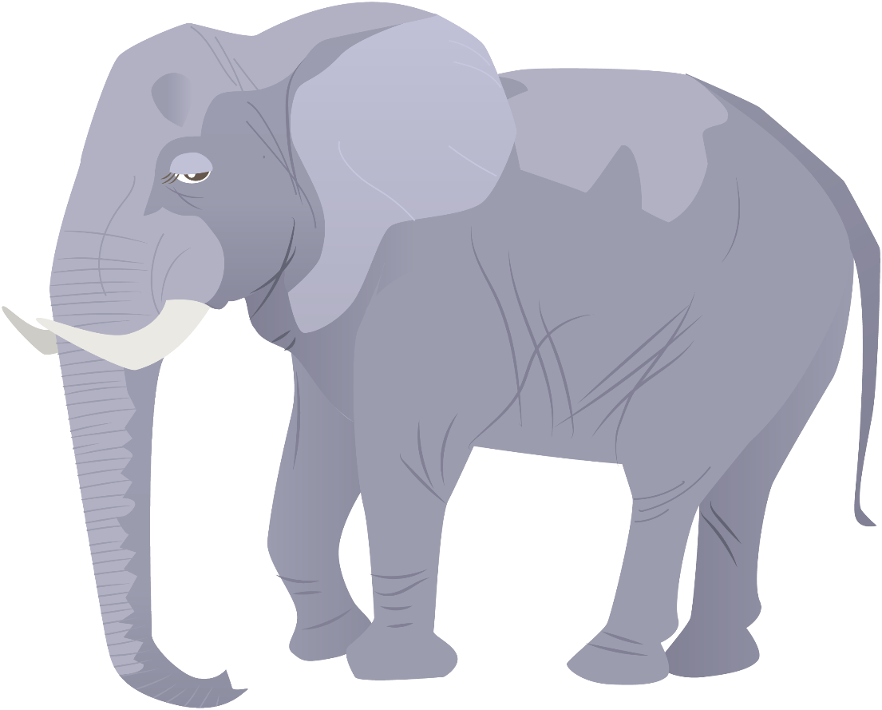
Information Report Example - Elephants
All elephants are mammals, like humans.
They usually live in grasslands, in Africa and Asia.
Elephants have bulky bodies, large ears and a long trunk.
They are all herbivores, which means they survive on a diet of plants.
Most elephants can live for 50 to 70 years in the wild.

Slide 12
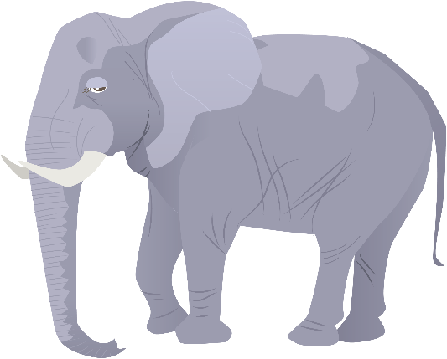
Information Report – Elephants
General Classification
All elephants are mammals, like humans.
Fact 1: Habitat
They usually live in grasslands, in Africa and Asia.
Fact 2: Appearance
Elephants have bulky bodies, large ears and a long trunk.
Fact 3: Diet
They are all herbivores, which means they survive on a diet of plants.
Concluding Sentence
Most elephants can live for 50 to 70 years.

Slide 13
Information Report Example - Eagles
Eagles of all kinds are a type of bird.
They mostly live in trees in wetland areas, all around the world.
Eagles have strong wings, a sharp beak and long talons.
They are all carnivores, crushing their prey with their sharp claws.
Most eagles can live for 20 to 25 years in the wild.

Slide 14
Information Report – Eagles
As a class, use the information report about eagles to complete the table.
General Classification
Fact 1: Habitat
Fact 2: Appearance
Fact 3: Diet
Concluding Sentence

Slide 15
Information Report – Eagles
General Classification
Eagles of all kinds are a type of bird.
Fact 1: Habitat
They mostly live in trees in wetland areas, all around the world.
Fact 2: Appearance
Eagles have strong wings, a sharp beak and long talons.
Fact 3: Diet
They are all carnivores, crushing their prey with their sharp claws.
Concluding Sentence
Most eagles can live for 20 to 25 years in the wild.

Slide 16
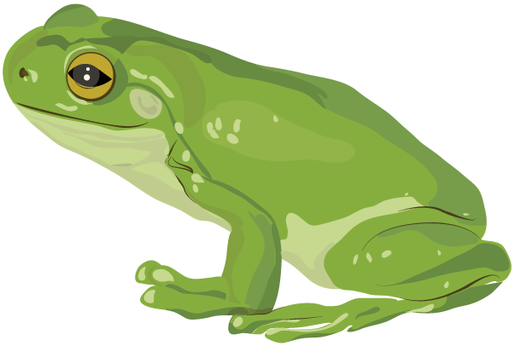
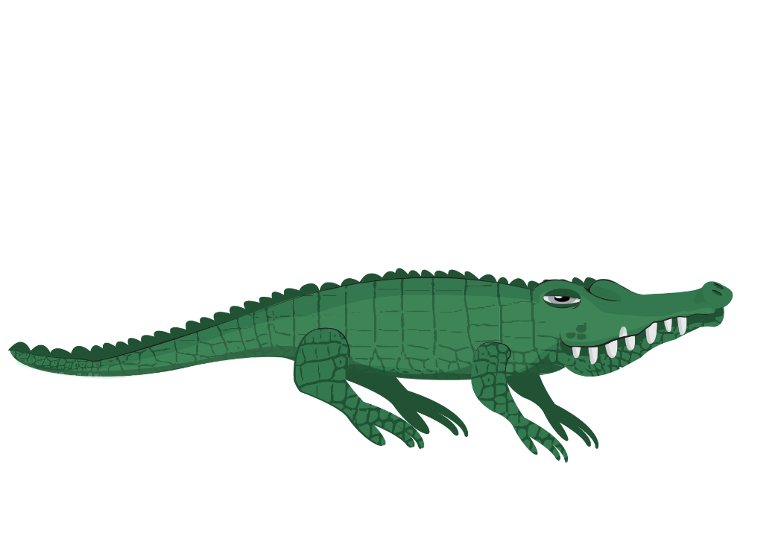
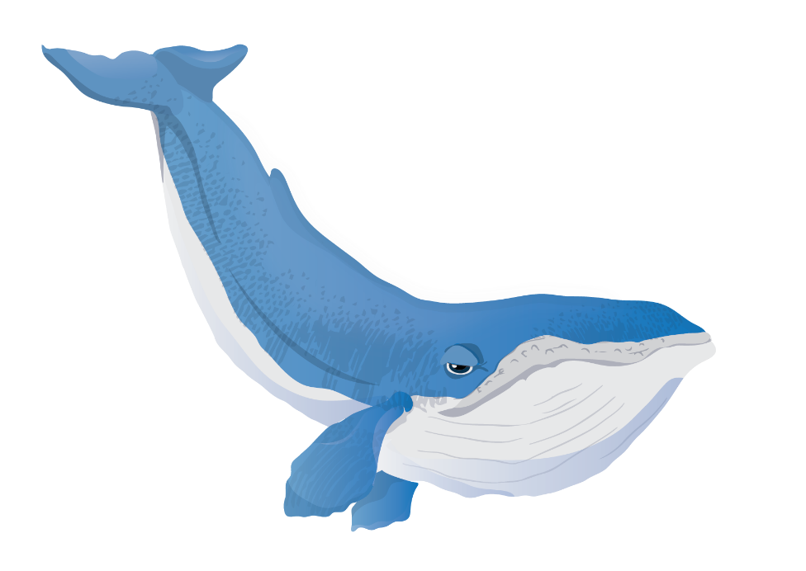
Information Report Structure - Activity
Complete the Information Report Structure - Sorting Activity. Choose from the following animals:
frogs
penguins
crocodiles
whales
butterflies.

Slide 17
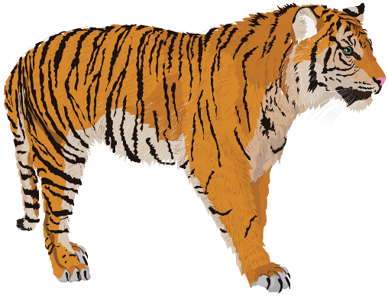
Informative Texts – Language
Informative texts usually use the following language features:
The Language of Generalisation
This is used to make general statements about a subject.
e.g. All tigers are mammals.
The Language of Description
This is used to describe the subject in a clear and factual way.
e.g. Tigers have strong bodies, broad paws and sharp teeth.
The Language of Comparison
This is used to describe similarities and differences.
e.g. Tigers are the largest member of the cat family.

Slide 18
Informative Language - Example
Find the language of generalisation, the language of description and the language of comparison in the following text.
All sharks are fish.
They usually live in salt water, but some live in fresh water.
Sharks have tiny scales, like teeth, all over their stream-lined bodies.
They are all carnivores, which means they are meat-eaters.
Most sharks can live for 20 to 30 years in the wild.

Slide 19
Informative Language - Answers
Find the language of generalisation, the language of description and the language of comparison in the following text.
All sharks are fish.
They usually live in salt water, but some live in fresh water.
Sharks have tiny scales, like teeth, all over their stream-lined bodies.
They are all carnivores, which means they are meat-eaters.
Most sharks can live for 20 to 30 years in the wild.

Slide 20
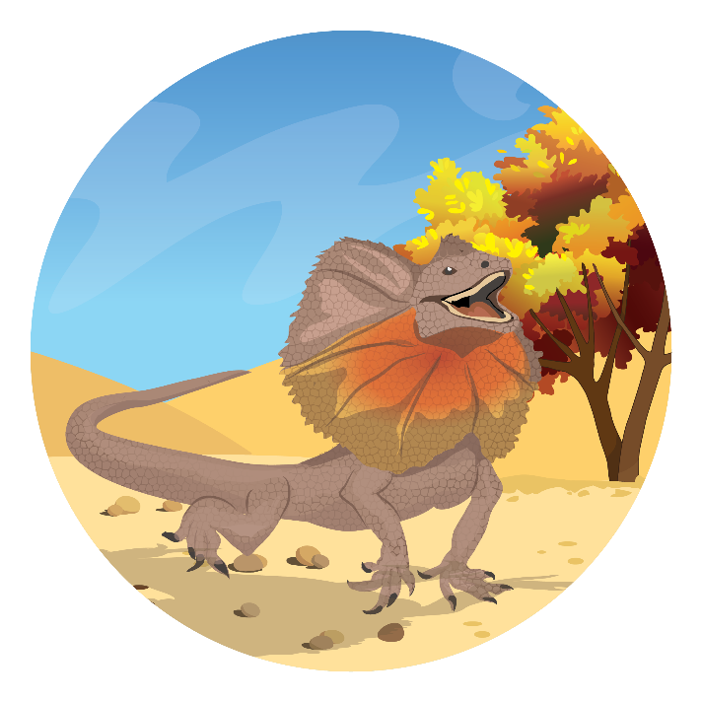
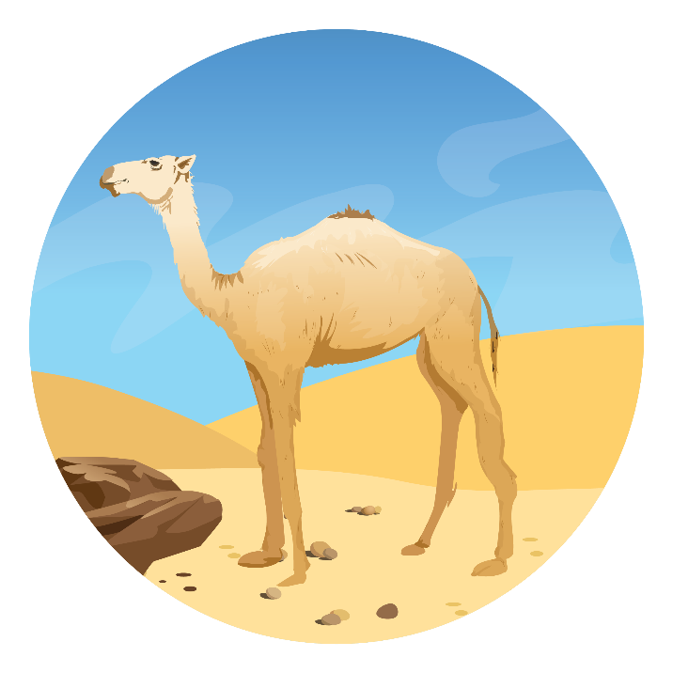
Informative Language - Activity
Choose one of the animals below. Use the language of generalisation, the language of description and the language of comparison to write some words to describe the animal.

